Slide 1

GRAINCHAIN-SUPPLY CHAIN TRACEABILITY APPLICATION USING BLOCKCHAIN
Department of Computer Science and Engineering
Mentor:
Dr. Priya Vijay,
Associate Professor
Team Members
1. Nanthiniannal J - 211616104143
2. Sriram V - 211616104237
3. Surabhi Ojha - 211616104249
Dept. of CSE, Final Project Review

Slide 2
ABSTRACT
In current technology there is no traceability of rice from the farmer to the end consumers.
This can lead to a variety of problems such as adulteration of rice, unfair pricing and stocking of the rice.
Stocking of the rice by middlemen leads to inflation.
Current supply chain management solutions are built over the top of the centralized database management systems which may be subjected to vulnerability, lack of data integrity and single point of failure.
Introducing blockchain in the field of supply chain management will avoid tampering with data and single point of failure.
Blockchain promotes trust in lack of trust environment.
Grainchain is a rice tracking system. This system enables the tracking of the rice right from farmer to retailer.
Dept. of CSE, Final Project Review

Slide 3
ABSTRACT
Grainchain promotes trust between the end consumer and the product they buy.
Grainchain is a completely decentralized and permissioned blockchain based application which enables the participant to perform transactions with each other.
It also facilitates the end consumer to track the commodity right from the farm to their plates. Grainchain is built using Hyperledger fabric.
Hyperledger fabric is a permissioned blockchain software which is suitable for all supply chain applications.
Dept. of CSE, Final Project Review

Slide 4
KEY CHALLENGES
Building enterprise level product using blockchain.
Understanding the working of Hyperledger Fabric.
Business considerations related to supply chain management.
Motivating the participants to use this application.
Challenges associated with flow of commodity.
Dept. of CSE, Final Project Review

Slide 5
MOTIVATION
In the system present today, there is no traceability of rice. This has lead to many problems.
Adulteration of rice is a severe problem which is faced by end consumers.
As there is no tracking back to the source of rice, the problem persists.
Farmers do not get fair price for their crops.
The middlemen stock the crop to sell it when the prices increases.
Blockchain is an immutable distributed ledger and a suitable technology for traceability in the supply chain.
Blockchain builds trust in a lack of trust environment. Consensus protocols ensures trust between the various participating parties.
Dept. of CSE, Final Project Review

Slide 6
OBJECTIVE
Grainchain is the user-friendly web application in which farmers, producers, distributors, retailers and end consumers can use it for updating the data about the production of rice and track the data. Farmers need to create an account for themselves with the social security number and need to update the quantity of rice they have produced. Producers, distributors and retailers get the product from farmers, producers and distributors respectively. Thus, end consumers can view and track the rice details along with the timestamp. The data is added in the blockchain for making it tamper proof. When the end consumer requests the application about the tracking details, the application fetches the data from the blockchain and stores it in a relational database for faster retrieval.
The main objectives of this project are:
To bring transparency to the process and to reduce the role of middlemen.
Avoid stocking of the product and unfair pricing.
Prevention of adulterating the rice.
Dept. of CSE, Final Project Review

Slide 7
Literature Survey
Traceability in Agri-Food Supply Chain Management [1]
Author : Miguel Pincheira Caro, Muhammad Salek Ali, Massimo Vecchio And Raffaele Giaffreda
Publication Year: 2018
The data from the IOT devices is made to directly update the Blockchain values instead of traditional centralized cloud databases. It was proposed in order to reduce the workload of manpower to update the values to the database and to make the database tamper proof one.
Advantages
Rely on heavily-centralized cloud infrastructures.
conﬁdentiality and auditability.
Disadvantages
Performance is limited to hardware architectures.
Dept. of CSE, Final Project Review

Slide 8
Literature Survey
Food Traceability Solution [2]
Author : Mark Kim, Brian Hilton, Zach Burks And Jordan Reyes
Publication Year: 2018
This paper introduces Harvest Network, a theoretical end-to-end, “farm-to-fork”, food traceability application integrating the Ethereum blockchain and IoT devices exchanging GS1 message standards. The goal is to create a distributed ledger accessible for all stakeholders in the supply chain.
Advantages
Distributed ledger accessible for all stakeholders in the supply chain.
Disadvantages
Using the public Ethereum blockchain means that ledger data can be viewed by anyone connected to the network.
Dept. of CSE, Final Project Review

Slide 9
Literature Survey
Food Safety Traceability System based on Blockchain and EPCIS [3]
Author : Qijun Lin, Huaizhen Wang, Xiaofu Pei And Junyu Wang
Publication Year: 2018
This paper proposes a food safety traceability system based on blockchain and EPC Information Services (EPCIS) and develops a prototype system. A management architecture of on-chain & off-chain data is proposed as well, through which the traceability system can alleviate the data explosion issue of the blockchain for Internet of Things (IoT).
Advantages
Efﬁciently detect and prevent food safety problems
Building a reliable traceability.
Disadvantages
The speed of data uploading to the blockchain is primarily restricted by the consensus algorithm.
Dept. of CSE, Final Project Review

Slide 10
Literature Survey
Soybean Traceability in Agricultural Supply Chain [4]
Author : Khaled Salah, Nishara Nizamuddin, Raja Jayaraman And Mohammad Omar
Publication Year: 2018
Approach that leverages the Ethereum blockchain and smart contracts efﬁciently to perform transactions for soybean tracking and traceability across the supply chain. Their proposed solution eliminates the need for a trusted centralized authority, intermediaries and provides transaction records, enhancing efﬁciency and safety with high integrity, reliability, and security
Advantages
Effective traceability solution that acts as an essential quality management tool ensuring adequate safety of products in the agricultural supply chain.
Disadvantages
Using the public Ethereum blockchain means that ledger data can be viewed by anyone connected to the network.
Dept. of CSE, Final Project Review

Slide 11
Literature Survey
AQUACHAIN -Water Supply-Chain management using Distributed Ledger Technology [5]
Author : Nibi Maouriyan And A.G.Achudh Krishna
Publication Year: 2018
Aqua-chain, a fully decentralized, blockchain-based traceability solution for Water supply chain management, able to seamlessly integrate IoT devices producing and consuming digital data along the chain. To effectively assess Aqua-chain, first, they defined a classical use-case within the given vertical domain, namely from-supplier-to-buyer.
Advantages
Solves data integrity, tampering and single points of failure.
Disadvantages
Ethereum is quite CPU-intensive and this may represent a barrier for computation.
limited devices, such as edge gateways and IoT devices.
Dept. of CSE, Final Project Review

Slide 12
Literature Survey
Improving Data Security in Message Communication between ACT and Aircraft using Private Blockchain [6]
Author : Yusuf Zakir, Khondker S. Hasan, Naomi S. Wiggins And Amlan Chatterjee
Publication Year: 2018
A set of new algorithms are proposed to outline various phases during communication and embedding message security. The proposed models are evaluated in a simulated environment for secure data communication between Flights and ACTs.
Advantages
Since it is a permissioned blockchain only authorized people can access data messages.
Prevention of security attacks like DDOS, Replay attacks.
It ensures data integrity.
Disadvantages
Efficiency of the proposed system can be improved.
Dept. of CSE, Final Project Review

Slide 13
Literature Survey
Double-Layer Framework for Product Traceability System [7]
Author : Qingyang Ding, Sheng Gao, Jianming Zhu And Chongxuan Yuan
Publication Year: 2019
This paper proposes a product traceability scheme based on the permissioned blockchain within a double layer framework. They introduced the double-layer framework and described its advantages in detail. They also describe the smart contracts in the double-layer framework. Finally, they tested the performance of the proposed scheme through simulation experiments.
Advantages
Make government regulation departments have a regulation function for the entire product supply chain.
Reduces regulatory costs for government agencies.
Disadvantages
Run time of a sub layer is low
Dept. of CSE, Final Project Review

Slide 14
Literature Survey
Operating Permissioned Blockchain in Clouds: A Performance Study of Hyperledger Sawtooth [8]
Author : Zeshun Shi, Huan Zhou, Yang Hu, Jayachander Surbiryala, Cees de Laat And Zhiming Zhao
Publication Year: 2018
Proposes performance of Sawtooth, a well known permissioned blockchain platforms from Hyperledger, in cloud environments. Our results provide insights for blockchain operators to optimize the performance of Sawtooth through adjusting the two conﬁguration parameters, i.e., Scheduler and Maximum Batches Per Block.
Advantages
Demonstrates the performance variation of Hyperledger sawtooth in a dynamic cloud environment.
Disadvantages
It does not analyze the performance of different permissioned blockchain platforms in the cloud.
Dept. of CSE, Final Project Review

Slide 15
Literature Survey
Blockchain in Logistics and Supply Chain: a Lean approach for designing real-world use cases [9]
Author : Guido Perboli, Stefano Musso And Mariangela Rosano
Publication Year: 2017
This paper proposes how the Blockchain will help in reducing the logistics costs and in optimizing the operations and the research challenges. It aims to filling the lack concerning the digital strategy, creating a standard methodology to design Blockchain technology use cases, which are not related to finance applications.
Advantages
It includes the analysis of the needs and the objectives of the different actors involved, with the aim to create a business model capable of highlighting the returns (both in economic and customer satisfaction terms) of this solution.
Disadvantages
It is thus necessary to set up overall volume controls to verify that no untracked products are inserted in the supply chain along the processes.
Dept. of CSE, Final Project Review

Slide 16
Literature Survey
Blockchain-Based Distributed Optimization for Energy Management Systems [10]
Author : Daiki Ogawa, Koichi Kobayashi And Yuh Yamashita
Publication Year: 2019
A blockchain-based distributed optimization method for energy management systems (EMSs) is studied. Distributed optimization is appropriate for large-scale multi-agent systems. In this paper, ADMM (Alternating Direction Method of Multipliers) is utilized as one of the powerful methods in distributed optimization. In ADMM, an aggregator is required for collecting the computation result in each agent.
Advantages
By numerical experiments, the effectiveness and limitation of blockchain-based distributed optimizationareclariﬁedfromtheviewpointsoftampertolerance and computation time.
Disadvantages
Computation time is high.
Dept. of CSE, Final Project Review

Slide 17
Need For Proposed System
In current technology there is no traceability of rice from the farmer to the end consumers.
This can lead to a variety of problems such as adulteration of rice, unfair pricing and stocking of rice.
Stocking of the rice by middlemen leads to inflation.
Farmers do not get fair price for their crops.
End Consumer receives the product which may be adulterated.
Current supply chain management solutions are built over the top of the centralized database management systems which may be subjected to vulnerability, lack of data integrity and single point of failure.
In the existing solutions end consumer cannot track the commodity.
Dept. of CSE, Final Project Review

Slide 18
ADVANTAGES OF PROPOSED SYSTEM
Grainchain is a Blockchain application hence is not subjected to single point of failure.
The proposed system can be used for any food product.
The data once stored cannot be modified.
This application uses consensus protocol to perform transaction creating trust between the participants.
The proposed system can be easily used by all participants.
Dept. of CSE, Final Project Review

Slide 19
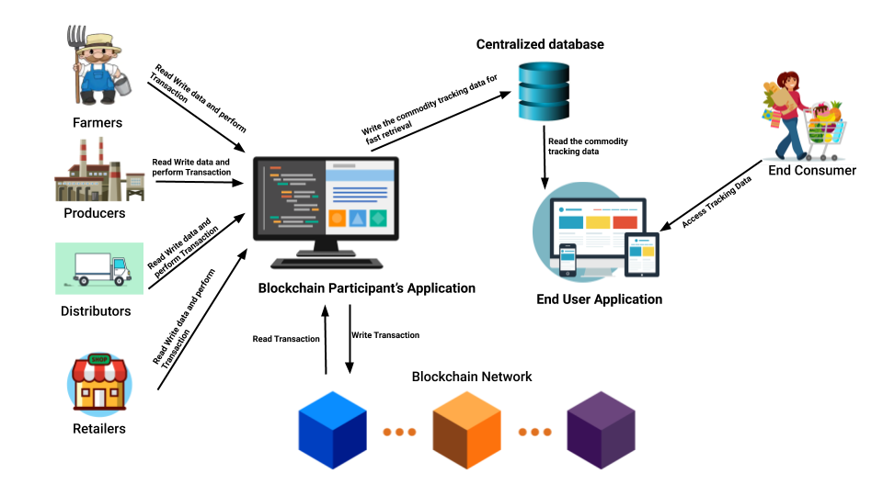
Architecture Diagram
Dept. of CSE, Final Project Review

Slide 20
System Requirements
Hardware
Processor - Intel core duo or higher
RAM - 4GB minimum
Disk - 50GB
Monitor - 15” color with VGI card
Speed - Min 500MHz
Software
OS - Ubuntu 16.04 LTS
cURL - Latest version
Docker - >= version 17.06.2-ce
Docker Compose - >= version 1.14.0
Dept. of CSE, Final Project Review

Slide 21
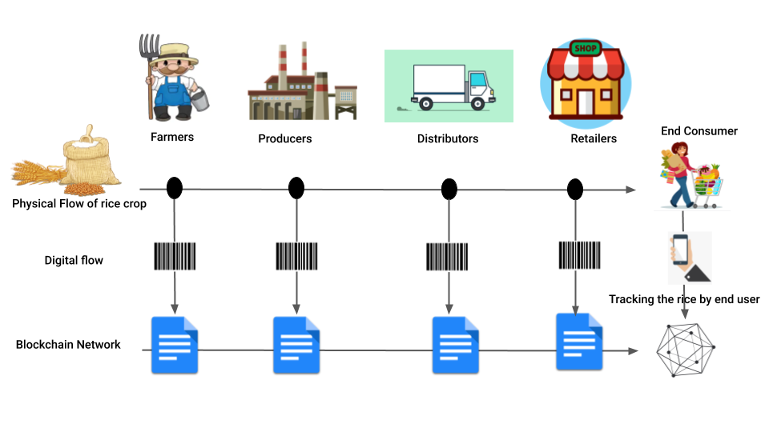
High Level View Of GrainChain Application
Dept. of CSE, Final Project Review

Slide 22
Functional Description and Implementation of Modules
1.SIGN UP:
This module is used for adding participants to the blockchain network. The participants can be added to the network. All the signup requests into the network are approved by an authorized administrator. Each participant added to the network is given a unique identification number that is used for performing transactions on the blockchain network. The unique identification number is usually provided by the government.
DFD Diagram
Enter Details
Store Details
Participants
Signup Users
Blockchain
Signup Successful / Failed
Acknowledgement
Dept. of CSE, Final Project Review

Slide 23
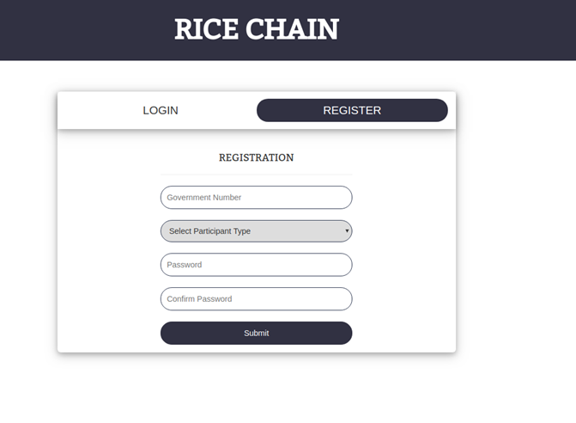
Functional Description and Implementation of Modules
IMPLEMENTATION
Fig: SignUp page
Dept. of CSE, Final Project Review

Slide 24
Functional Description and Implementation of Modules
2.LOGIN:
This module is used for logging a participant into the network. The network participants must provide the unique identification number and the password for logging into the network. With correct credentials, the participant gains access to a portal where they can perform transactions and view details in the blockchain network.
DFD Diagram
Enter Details
Fetch Details
Participants
Login Users
Blockchain
Login Successful / Failed
Provide Details
Dept. of CSE, Final Project Review

Slide 25
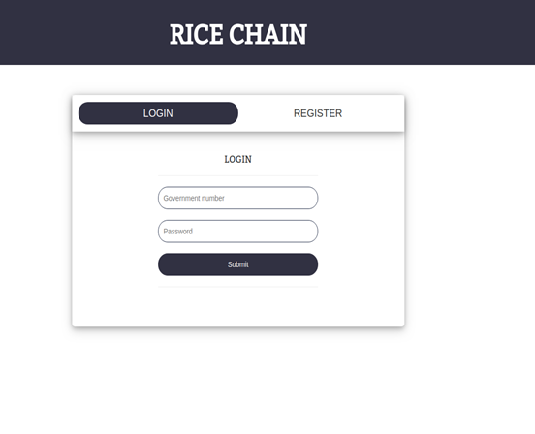
Functional Description and Implementation of Modules
IMPLEMENTATION
Fig: Login page
Dept. of CSE, Final Project Review

Slide 26
Functional Description and Implementation of Modules
3.CREATE COMMODITY:
This module is used for adding the commodity into the blockchain network. In our case, the commodity is rice and it is added as paddy (brown rice) initially into the network. Since paddy is a commodity that is produced only by farmers, this module can be accessed to create commodity into the network only by farmer participants. No other participant has access to this module.
DFD Diagram
Enter Commodity Details
Store Details
Create Commodity
Farmer
Blockchain
Commodity creation Successful / Failed
Acknowledgement
Dept. of CSE, Final Project Review

Slide 27
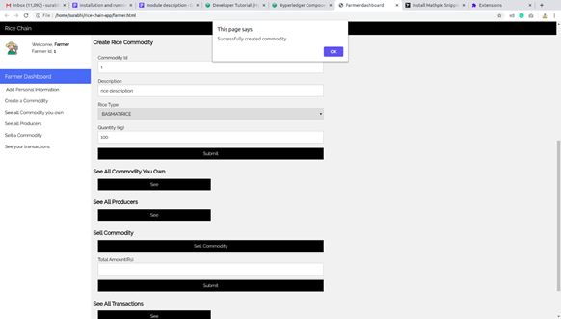
Functional Description and Implementation of Modules
IMPLEMENTATION
Dept. of CSE, Final Project Review

Slide 28
Functional Description and Implementation of Modules
4.SELL COMMODITY:
This module is used for transferring a commodity from one participant to another. There are three stages of transfer. A farmer can sell the commodity only to a producer. A producer in turn can sell the commodity only to a distributor. A distributor can sell the commodity only to a retailer. Every time a sell commodity module is invoked, the stage of the product changes.
DFD Diagram
Enter Commodity Details
Store Details
Sell Commodity
Participants
Blockchain
Selling of Commodity Successful / Failed
Acknowledgement
Dept. of CSE, Final Project Review

Slide 29
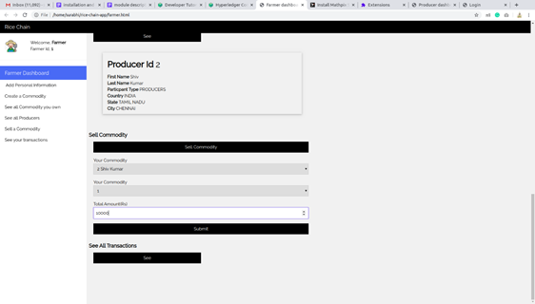
Functional Description and Implementation of Modules
IMPLEMENTATION
Dept. of CSE, Final Project Review

Slide 30
Functional Description and Implementation of Modules
5.SEE ALL FARMERS:
This module is used to display all the farmers present in the network. This module is accessible only by the administrator. All the farmers in the network are first queried from the blockchain and then displayed to the administrator.
DFD Diagram
Enter Details
Fetch Details
Admin
See All Farmers
Blockchain
All Farmers details
Provide Details
Dept. of CSE, Final Project Review

Slide 31
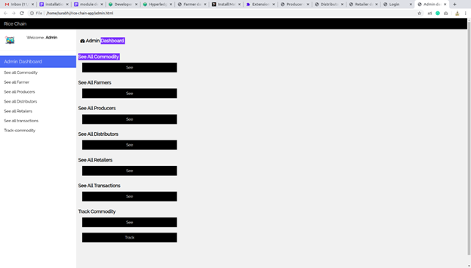
Functional Description and Implementation of Modules
IMPLEMENTATION
Dept. of CSE, Final Project Review

Slide 32
Functional Description and Implementation of Modules
6.SEE ALL PRODUCERS:
This module is used to display all the producers present in the network. This module is accessible by the administrator as well as the farmer. A farmer can view all the producers in the network and sell the commodity to anyone of them.
DFD Diagram
Enter Details
Fetch Details
Admin / Farmer
See All Producers
Blockchain
All Producers details
Provide Details
Dept. of CSE, Final Project Review

Slide 33
Functional Description and Implementation of Modules
IMPLEMENTATION
Dept. of CSE, Final Project Review

Slide 34
Functional Description and Implementation of Modules
7.SEE ALL DISTRIBUTORS:
This module is used to display all the distributors present in the network. This module is accessible by the administrator as well as the producer. A producer can view all the distributors in the network and sell the commodity to anyone of them.
DFD Diagram
Enter Details
Fetch Details
Admin/ Producers
See All Distributors
Blockchain
All Distributors details
Provide Details
Dept. of CSE, Final Project Review

Slide 35
Functional Description and Implementation of Modules
IMPLEMENTATION
Dept. of CSE, Final Project Review

Slide 36
Functional Description and Implementation of Modules
8.SEE ALL RETAILERS:
This module is used to display all the retailers present in the network. This module is accessible by the administrator as well as the distributor. A distributor can view all the retailers in the network and sell the commodity to anyone of them.
DFD Diagram
Enter Details
Fetch Details
Admin/
Distributors
See All Retailers
Blockchain
All Retailers details
Provide Details
Dept. of CSE, Final Project Review

Slide 37
Functional Description and Implementation of Modules
IMPLEMENTATION
Dept. of CSE, Final Project Review

Slide 38
Functional Description and Implementation of Modules
9.SEE COMMODITY:
This module is used to display all the commodities that are owned by a participant. This module is also accessible to the administrator and he can view all the commodities currently in the network. A participant makes use of this module in order to find all the commodities in his inventory and deciding the participant to whom the commodity will be sold.
DFD Diagram
Enter Details
Fetch Details
Participants
See Commodity
Blockchain
Commodity details
Provide Details
Dept. of CSE, Final Project Review

Slide 39
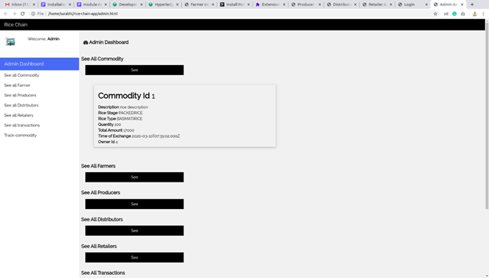
Functional Description and Implementation of Modules
IMPLEMENTATION
Dept. of CSE, Final Project Review

Slide 40
Functional Description and Implementation of Modules
10.SEE TRANSACTION:
This module is used to display all the transactions that have been performed by a participant. This module is accessible by both the participant and the administrator. An administrator can view all the transactions that are recorded in the network. A participant can view only those transactions that have been performed by them.
DFD Diagram
Enter Details
Fetch Details
See Transaction
Participants
Blockchain
Transaction details
Provide Details
Dept. of CSE, Final Project Review

Slide 41
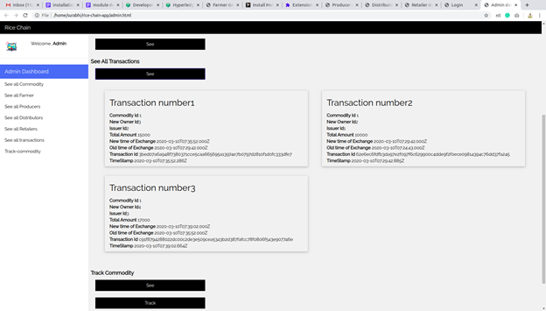
Functional Description and Implementation of Modules
IMPLEMENTATION
Dept. of CSE, Final Project Review

Slide 42
Functional Description and Implementation of Modules
11.TRACK COMMODITY:
This module is used to track a commodity in the network. The tracking is performed by querying the network using the unique commodity id assigned to each commodity during its creation. This module is accessible by the administrator and the consumers. Consumers can access only abstracted information.
DFD Diagram
Enter Details
Fetch Details
Participants
Track Commodity
Blockchain
Commodity Tracking details
Provide Details
Dept. of CSE, Final Project Review

Slide 43
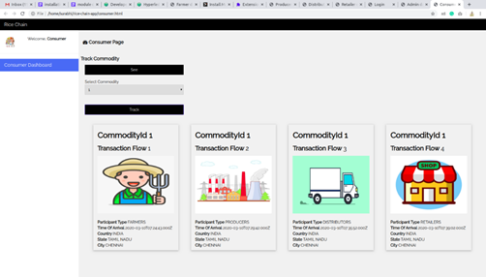
Functional Description and Implementation of Modules
IMPLEMENTATION
Dept. of CSE, Final Project Review

Slide 44
Blockchain Ledger Design(Database Design)
COMMODITY BLOCK
Attributes | Datatype | Constraints
tradingSymbol | String | Primary key
description | String
riceStage | StageOfRice | Connected to enum
riceType | TypesOfRice | Connected to enum
quantity | Double
totalAmount | Double
timeOfMakingCommodityOrMakingTransaction | DateTime
owner | Trader | Foreign Key
Dept. of CSE, Final Project Review

Slide 45
Blockchain Ledger Design
PARTICIPANT BLOCK
Attributes | Datatype | Constraints
traderId | String | Primary key
firstName | String
lastName | String
participantType | TypesOfParticipant | Connected to enum
participantAddress | AddressOfParticipant | Connected to concept
Dept. of CSE, Final Project Review

Slide 46
Blockchain Ledger Design
TRANSACTION BLOCK
Attributes | Datatype | Constraints
commodity | Commodity | Foreign Key
newOwner | Trader | Foreign Key
issuer | Trader | Connected to enum
totalAmount | Double
timeOfMakingExchange | DateTime
commodityTimeOfMakingCommodityOrMakingTransaction | DateTime
Dept. of CSE, Final Project Review

Slide 47
Blockchain Ledger Design
AddressOfParticipant Concept Block
Attributes | Datatype
country | String
state | String
city | String
street | String
pincode | String
Dept. of CSE, Final Project Review

Slide 48
Blockchain Ledger Design
ENUM Data Store
StageOfRice | TypesOfRice | TypesOfParticipant
BROWNRICE | BASMATIRICE | FARMERS
WHITERICE | SAMBAMASURIRICE | PRODUCERS
PACKEDRICE | BROWNRICE | DISTRIBUTORS
 | WHITERICE | RETAILERS
 | BLACKRICE
 | OTHERS
Dept. of CSE, Final Project Review

Slide 49
Testing
1.User ID and password validation:
This page validate user ID and password. It throws error message when the user enters invalid credentials.
Dept. of CSE, Final Project Review

Slide 50
Testing
2.Profile update validation:
After successful registration, the user needs to update their profile in the profile dashboard. In order to avoid the common mistakes by the user, drop down is made to select the content available. If the user has successfully completed the profile update, then an alert box is generated to make aware the users that the profile is successfully updated. After updating, the new details will get reflected in the dashboard.
Dept. of CSE, Final Project Review

Slide 51
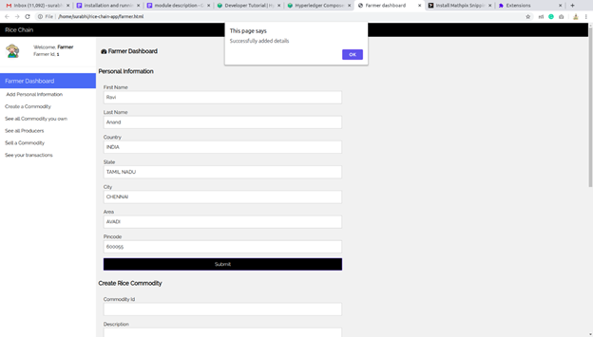
Testing
Dept. of CSE, Final Project Review

Slide 52
Testing
3.Update transaction validation:
After the successful completion of the transaction, again an alert box is generated, which shows that the transaction is completed successfully. If there is any error while performing transaction, then the same alert box will get generated with the error information.
Dept. of CSE, Final Project Review

Slide 53
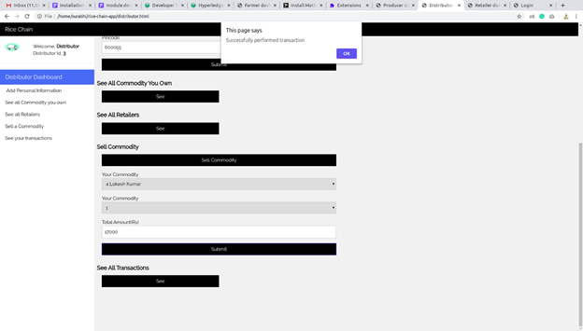
Testing
Dept. of CSE, Final Project Review

Slide 54
Conclusions
This Grainchain application can be extensively used by merchants and end consumer to ensure proper tracking of rice. Grainchain is the user- friendly web application which can be easily accessed by all the stakeholders involved.
Dept. of CSE, Final Project Review

Slide 55
Future Enhancements
The application can be further automated using IOT devices. The data from IOT devices automatically validate and update the commodity details in the blockchain which reduces the middleman in the application.
This application can be further improved by introducing rating system to the producer, distributor and retailer so that the participants can check the rating before selling their commodity.
Dept. of CSE, Final Project Review

Slide 56
Bibliography
Journals:
Androulaki, E., Barger, A., Bortnikov, V., Cachin, C., Christidis, K., De Caro, A., ... & Muralidharan, S. (2018, April). Hyperledger fabric: a distributed operating system for permissioned blockchains. In Proceedings of the Thirteenth EuroSys Conference (pp. 1-15).
Nakamoto, S. (2019). Bitcoin: A peer-to-peer electronic cash system. Manubot.
Tian, F. (2017, June). A supply chain traceability system for food safety based on HACCP, blockchain & Internet of things. In 2017 International conference on service systems and service management (pp. 1-6). IEEE.
Rahmadika, S., Kweka, B. J., Latt, C. N. Z., & Rhee, K. H. (2018, November). A preliminary approach of blockchain technology in supply chain system. In 2018 IEEE International Conference on Data Mining Workshops (ICDMW) (pp. 156-160). IEEE.
Salah, K., Nizamuddin, N., Jayaraman, R., & Omar, M. (2019). Blockchain-based soybean traceability in agricultural supply chain. IEEE Access, 7, 73295-73305.
Dept. of CSE, Final Project Review

Slide 57
Bibliography
Websites:
https://hyperledger-fabric.readthedocs.io/en/release-2.0/
https://hyperledger.github.io/composer/latest/introduction/introduction.html
https://blockgeeks.com/
https://developer.mozilla.org/en-US/docs/Web/JavaScript
https://www.w3schools.com/
Dept. of CSE, Final Project Review

Slide 58
Questions ?
Dept. of CSE, Final Project Review

Slide 59
Thank You
Dept. of CSE, Final Project Review

